Slide 1
Modelling & Analysis of the behavior of a robotic agent in Robot-Soccer
Project by:
Sunil Kumar Rajendran (G00982547)
Venkata Sasikiran Veeramachaneni (G00977751)

Slide 2
What is robot soccer..???
Soccer where teams are formed by Robots instead of humans
RoboCup is an annual international robotics competition which aims at promoting robotics and AI research, by offering a publicly appealing but formidable challenge.
RoboCup is contraction of the full name “Robot Soccer World Cup”
IBM Deep Blue defeated the human world champion in chess in 1997, which concluded the forty years challenge in AI community.
This accomplishment led the RoboCup to make its first step towards development of robotic soccer players.
Established in 1997 with the ultimate goal to develop a robot soccer team which beats the human world champion team by 2050.
Robot Soccer is one of the leagues organized by RoboCup and has been subcategorized based on the size of robots.

Slide 3
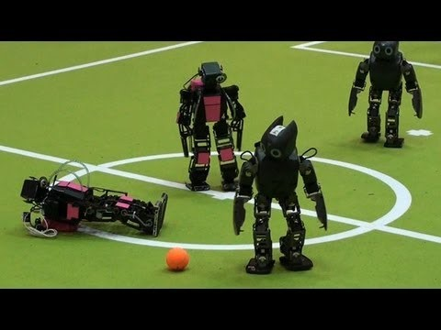
Just to have an idea..!!

Slide 4
System overview
System under consideration is a simplified version of real world Robot Soccer.
A single robot is placed in a soccer field of length 60 units(y-axis) and breadth 30 units.(x-axis).
The goal area lies between the coordinates (12.5,60) and (17.5,60).
The center point of the goal is (15,60) which will be considered as the initial goal point.
(30,0)
(30,60)
30
(0,0)
(0,60)
60
Axes have been inverted for viewing purpose

Slide 5
System overview…..(cont.)
180
270
90
0
Ball will be placed inside the field and the position will be denoted as a colored token by three attributes ‘x’, ’y’, ’field’.
Robot is also placed inside the field and position is denoted by three attributes ‘x’, ‘y’, ’theta’.
Once we start the system, the robot tracks the ball and tries to reach it.
If the robot reaches the ball, it kicks it in the direction of goal point.
This process repeats until the ball is kicked into region of goal point, which is a circle around the point with a radius of 2 distance units.
If the ball is in goal point region, it chooses the final goal point with x- coordinate Gaussian distributed around the former goal point x- coordinate and y-coordinate equal to former goal point y- coordinate
If any static obstacle comes, it deviates and chooses a new path

Slide 6
Analysis objectives
Analyze the path taken by the robot and ball if the time optimal strategy is used.
Examine the path taken by the robot incase it comes across an obstacle while approaching the ball
Analyze the path taken by the robot and the ball incase it comes across an obstacle while it is kicking the ball in the direction of goal point
Discover the path taken by the robot and the ball incase it comes across obstacles in both stages- approaching the ball and Kicking the ball.
Inspect the time taken, in time units, to make a goal.
Find out the number of steps the robot has to move in order to make a goal

Slide 7
assumptions
Every thing in this project is confined to 2-dimenstional space and all the objects in our consideration like robot, ball and obstacle are located by the position of their corresponding center of mass.
Robot agent involved is an autonomous one. It decides it’s path based on opted strategies.
Robot behavior is discretized and spends either in Walking state or Tracking state or Kicking state during our analysis.
Each state of the robot is considered as non-atomic state and is further divided into atomic states
Every step of robot is considered as one unit distance and it takes one time unit for the robot to move one step.
Ball dynamics have been simplified and every time it is kicked, it moves a distance of 2 units in one time unit in the kicked direction.
Still-tracking of ball takes one time unit and parallel-tracking of ball doesn’t take any time as it is a parallel process.
Once the goal is made the system reaches deadlock state.

Slide 8
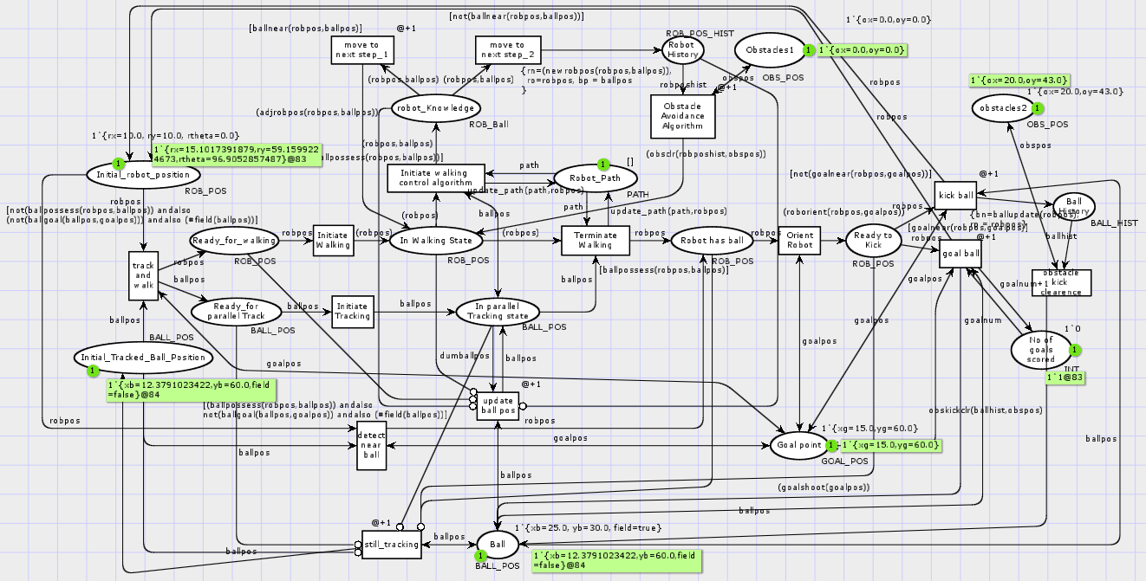
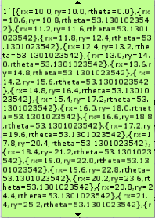

Slide 9
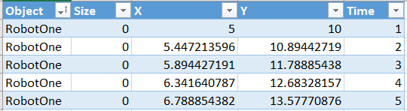
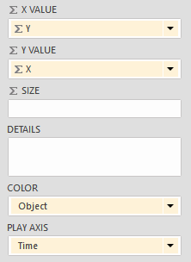
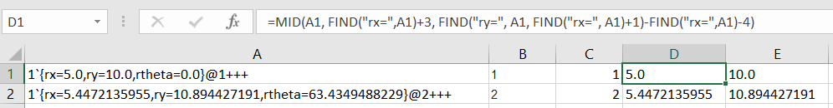
How the data was extracted..??

Slide 10
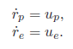
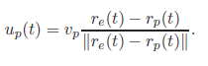
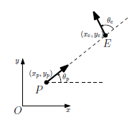
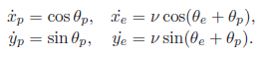
Time optimal strategy
Robot path is planned basing on the classical pursuit dynamics.

Slide 11
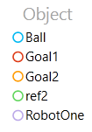
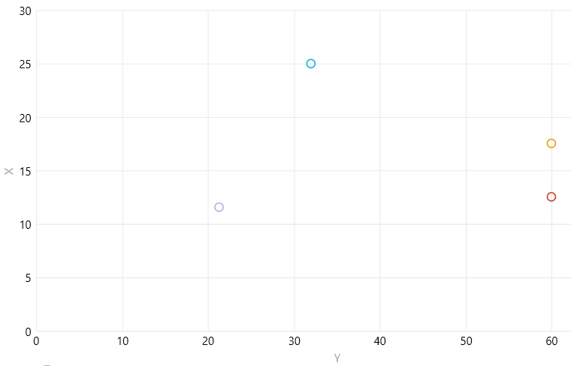
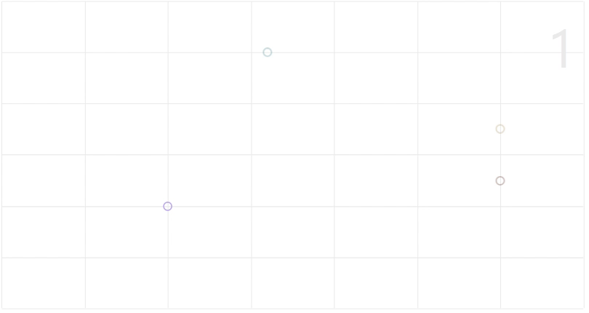
Strategy analysis
Robot – (10,20)
Ball – (25,32)
Steps - 49
Time - 64

Slide 12
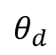
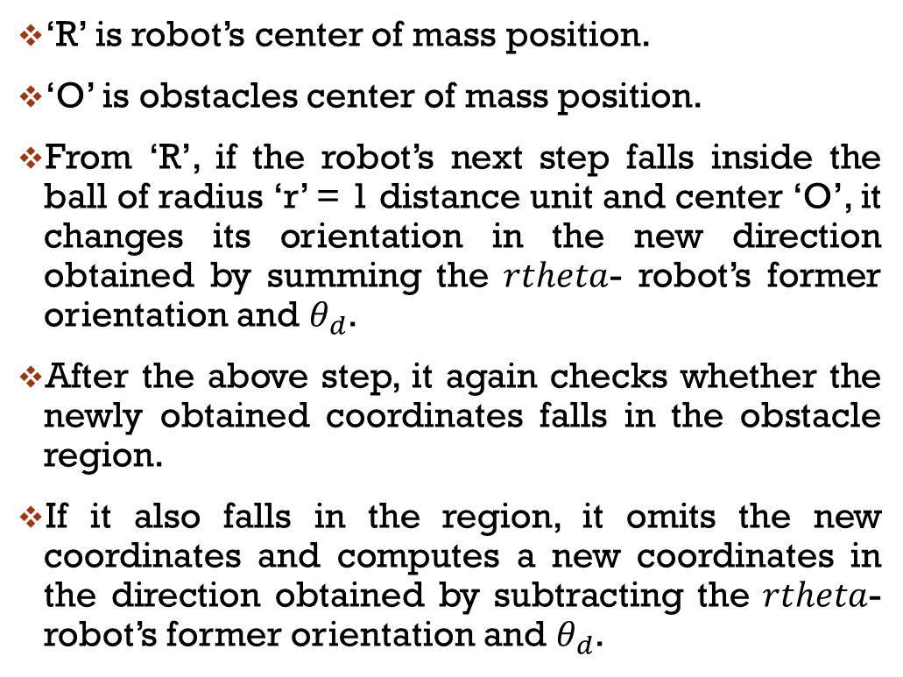
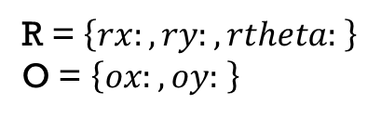
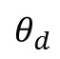
Obstacle avoidance while approaching the ball
‘R’ is robot’s center of mass position.
‘O’ is obstacles center of mass position.
From ‘R’, if the robot’s next step falls inside the ball of radius ‘r’ = 1 distance unit and center ‘O’, it changes its orientation in the new direction obtained by summing the $rtheta$- robot’s former orientation and $θ_{d}$.
After the above step, it again checks whether the newly obtained coordinates falls in the obstacle region.
If it also falls in the region, it omits the new coordinates and computes a new coordinates in the direction obtained by subtracting the $rtheta$- robot’s former orientation and $θ_{d}$.
R = $\left\{rx:,ry:,rtheta: \right\}$
O = $\left\{ox:,oy: \right\}$
r
$$θ_{d}$$
O
R
$$θ_{d}$$

Slide 13
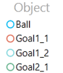
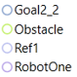
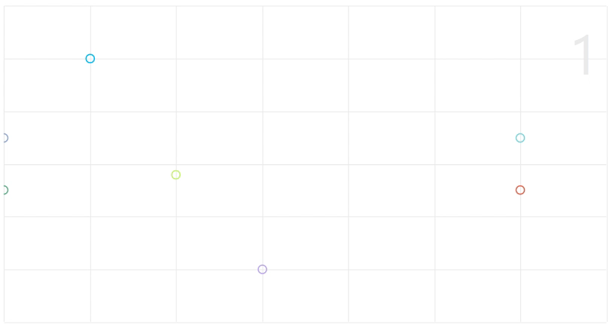
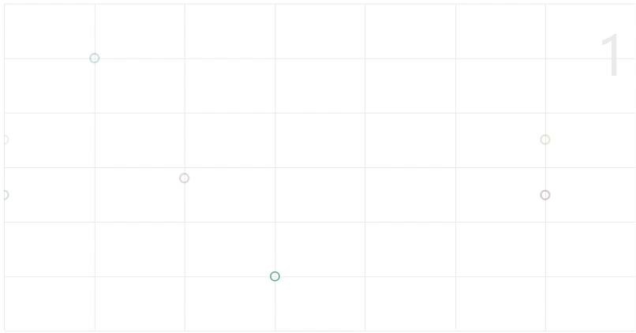
Strategy analysis
Robot – (5,30)
Ball – (25,10)
Obstacle – (14,20)
Steps -- 80
Time -- 106

Slide 14
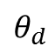
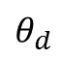
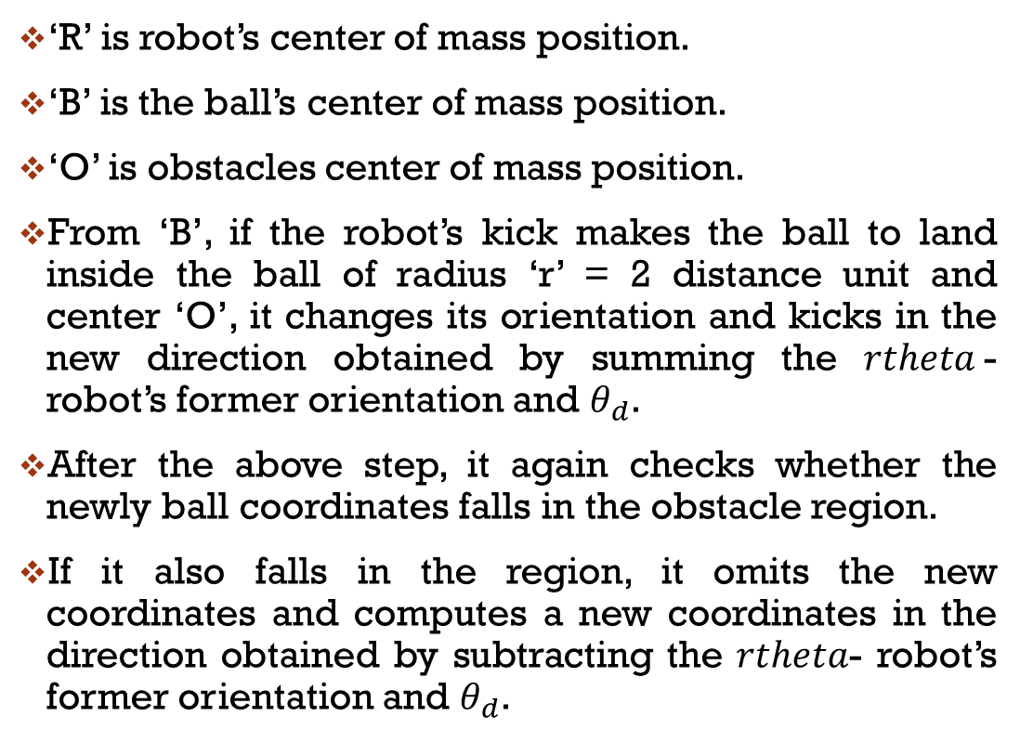
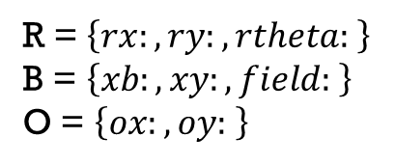
Obstacle avoidance while kicking the ball to goal
R = $\left\{rx:,ry:,rtheta: \right\}$
B = $\left\{xb:,xy:,field: \right\}$
O = $\left\{ox:,oy: \right\}$
‘R’ is robot’s center of mass position.
‘B’ is the ball’s center of mass position.
‘O’ is obstacles center of mass position.
From ‘B’, if the robot’s kick makes the ball to land inside the ball of radius ‘r’ = 2 distance unit and center ‘O’, it changes its orientation and kicks in the new direction obtained by summing the $rtheta$- robot’s former orientation and $θ_{d}$.
After the above step, it again checks whether the newly ball coordinates falls in the obstacle region.
If it also falls in the region, it omits the new coordinates and computes a new coordinates in the direction obtained by subtracting the $rtheta$- robot’s former orientation and $θ_{d}$.
r
R,B
$$θ_{d}$$
O
$$θ_{d}$$

Slide 15
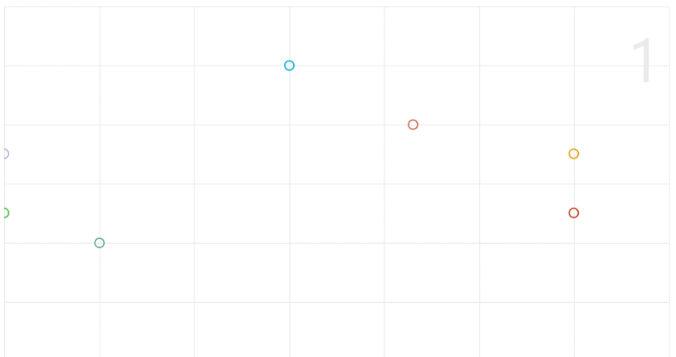
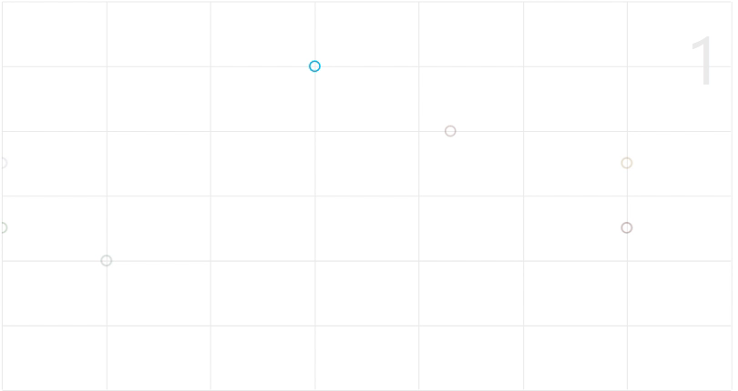
Strategy analysis
Robot – (10,10)
Ball – (25,30)
Obstacle – (20,43)
Steps - 65
Time - 83

Slide 16
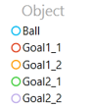
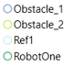
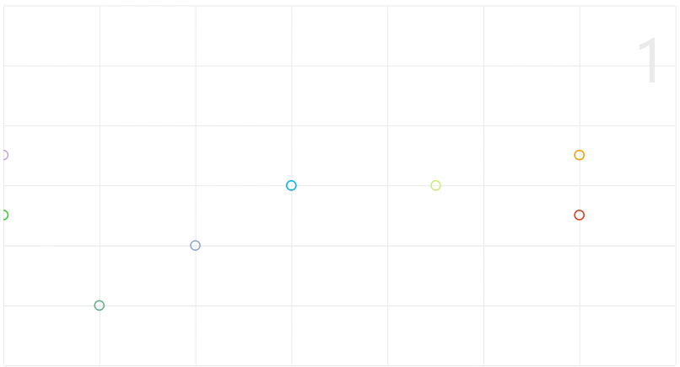
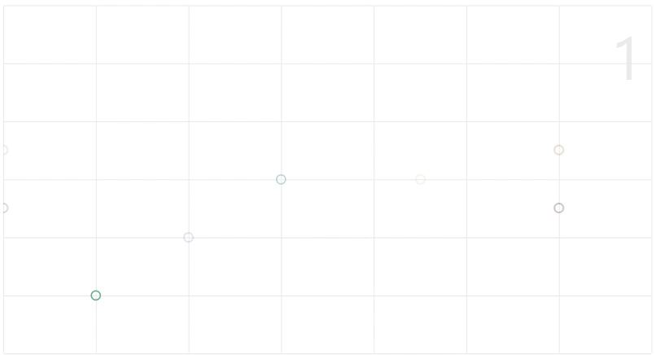
Everything together..!!
Robot – (5,10)
Ball – (15,30)
Obstacle 1 – (10,20)
Obstacle 2 – (15,45)
Steps - 58
Time - 75

Slide 17
Lessons learnt
Got idea how to discretize a continuous system and model it as a discrete event system.
Realized that CPN doesn’t play well with truncated values.
Had some hard time in coding complex functions but we could get across it
Able to learn how inhibitor arc works in presence of timed tokens.
When we tried to implement hierarchy on the fully developed net, we realized that it cannot be abstracted because of the structure.
Tried to have multiple agents on the field and make them play one against another. It didn’t succeed and gave us invalid data.

Slide 18



Any questions…???

